Slide 1
Predicting BMI from Food Acquisition and Availability
CIS 3200 - Data Processing and Analytics
by Alan Liu

Slide 2
Project Goal
Create a machine learning model using Azure ML Studio that can accurately predict an individual's body mass index (BMI) given the frequency of various food sources near their household.

Slide 3
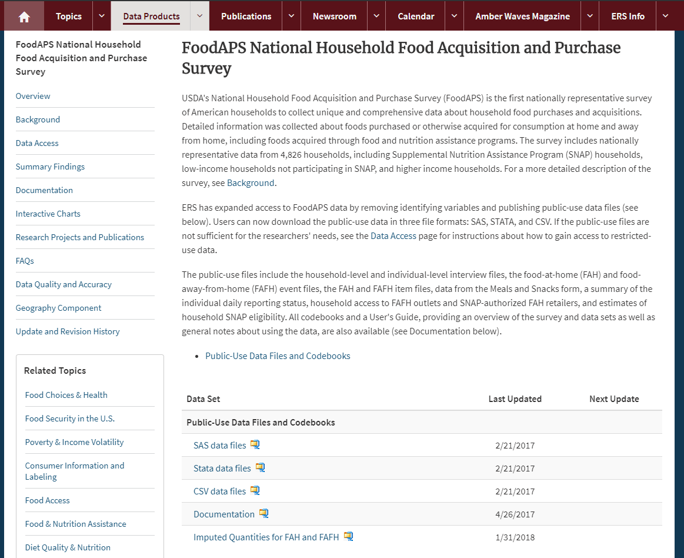
USDA Food Acquisition and Purchase Survey
Data Size: 181.3MB
Source: https://www.ers.usda.gov/data-products/foodaps-national-household-food-acquisition-and-purchase-survey/

Slide 4
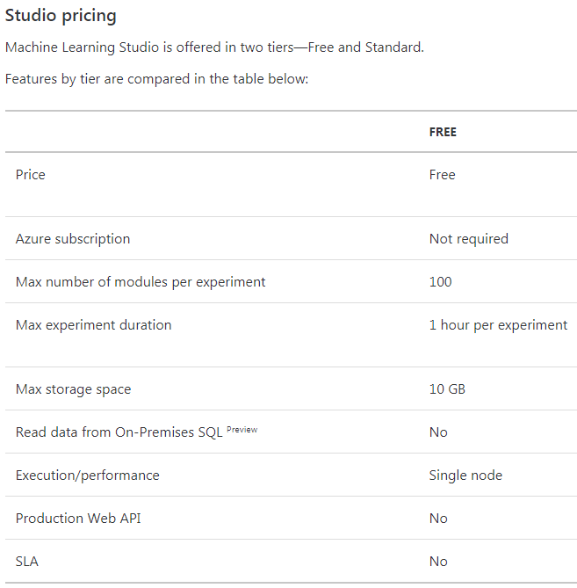
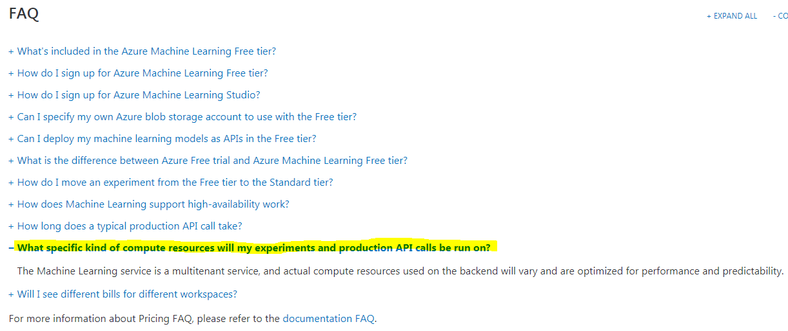
Specification: Microsoft Azure ML Studio
Completely managed cloud platform; can't know.

Slide 5
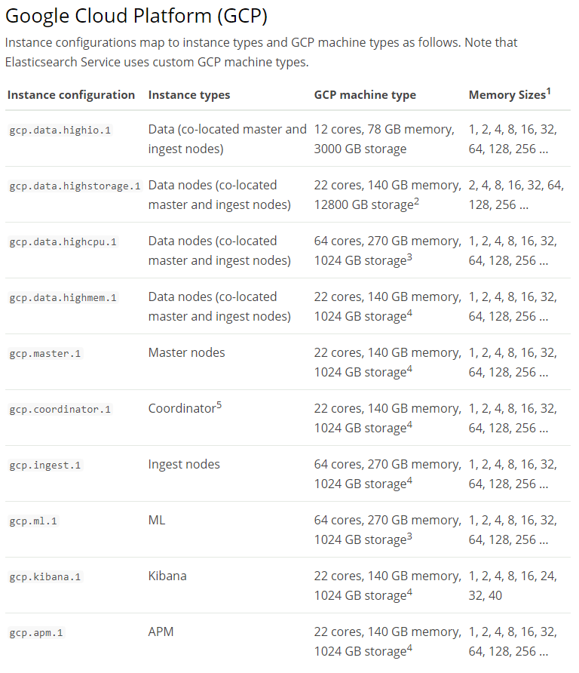
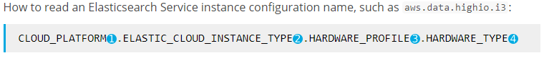
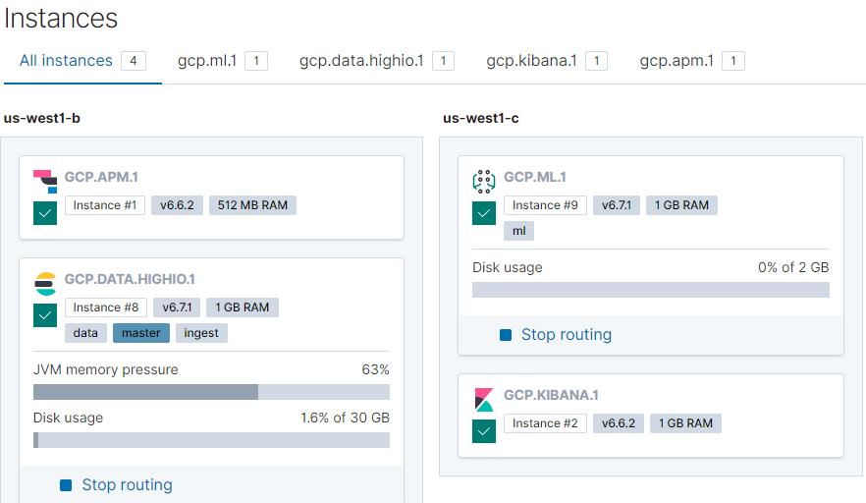
Specification: Elasticsearch Service
Managed cloud service
Multi-tenant
Configurations provisioned as instances on machines

Slide 6
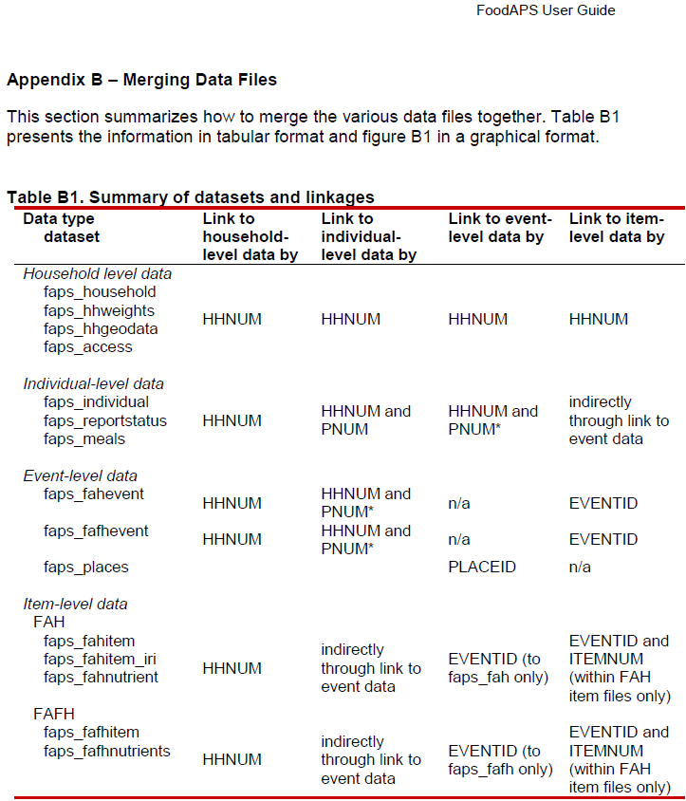
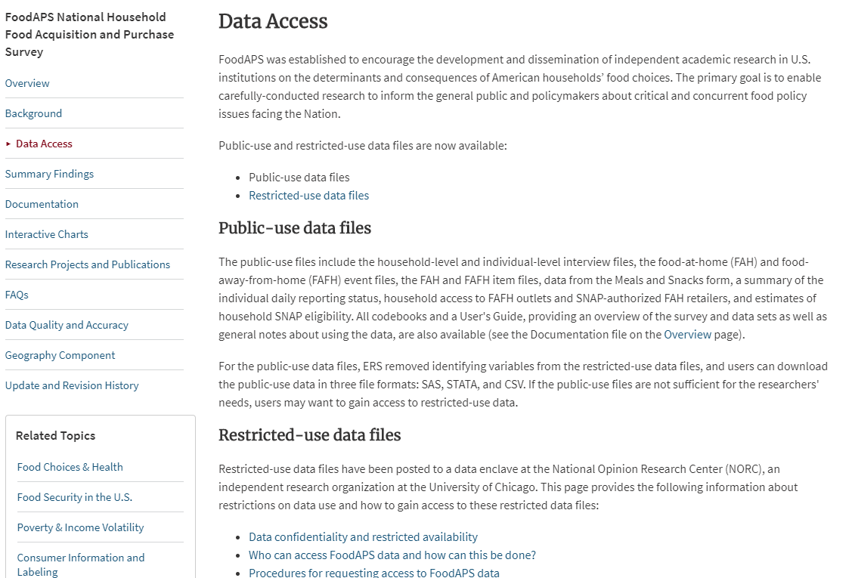
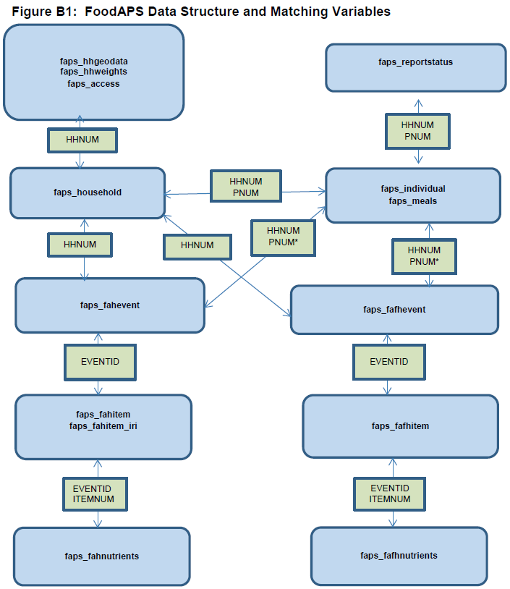
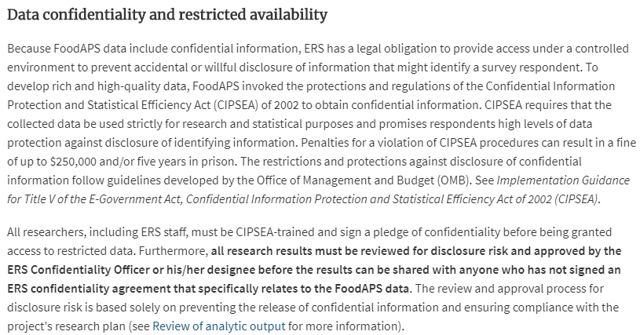
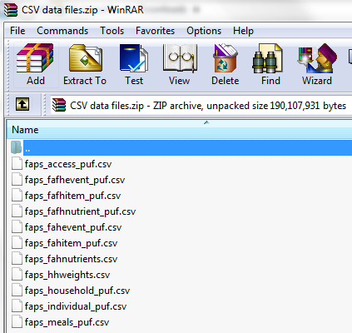
The Data
Dataset consists of multiple csv files.
Each table has key columns that can be used to link data together.

Slide 7
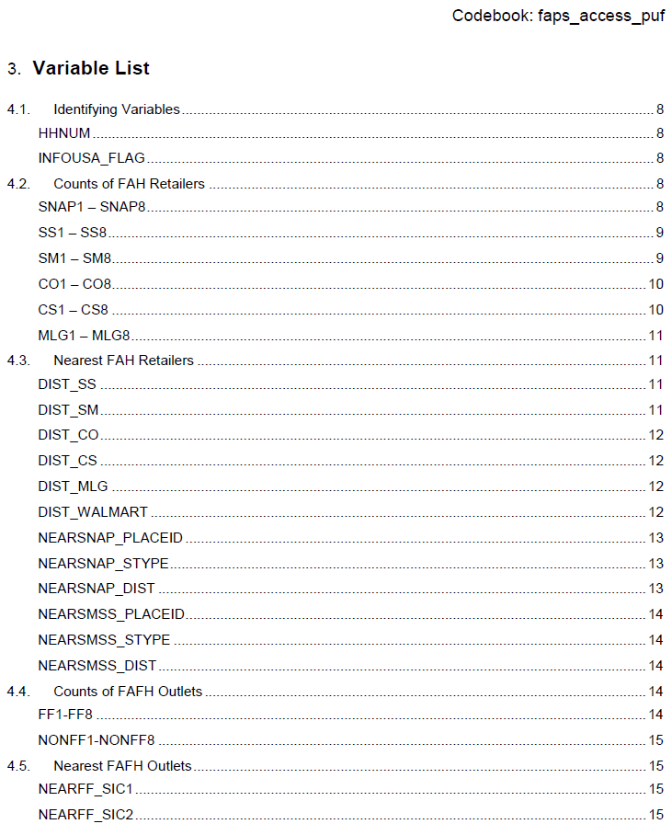
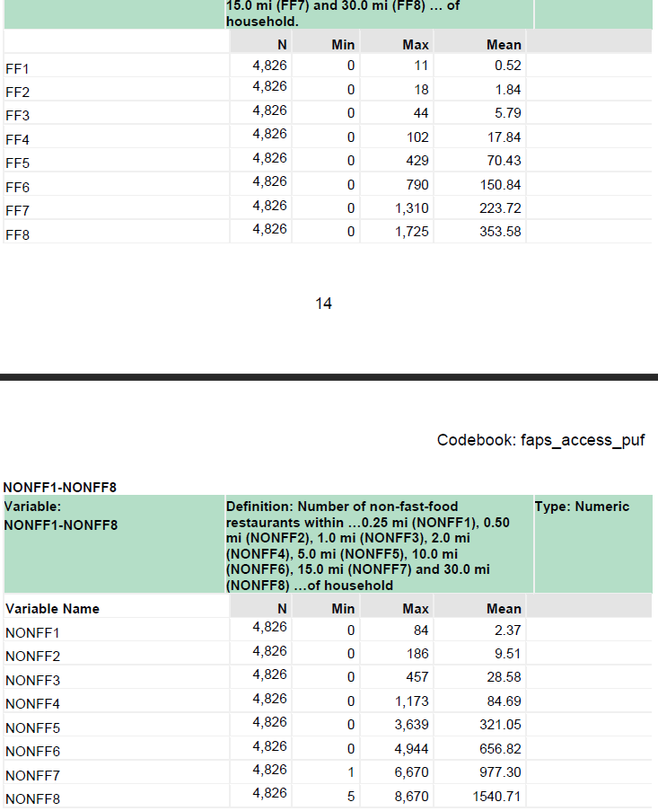
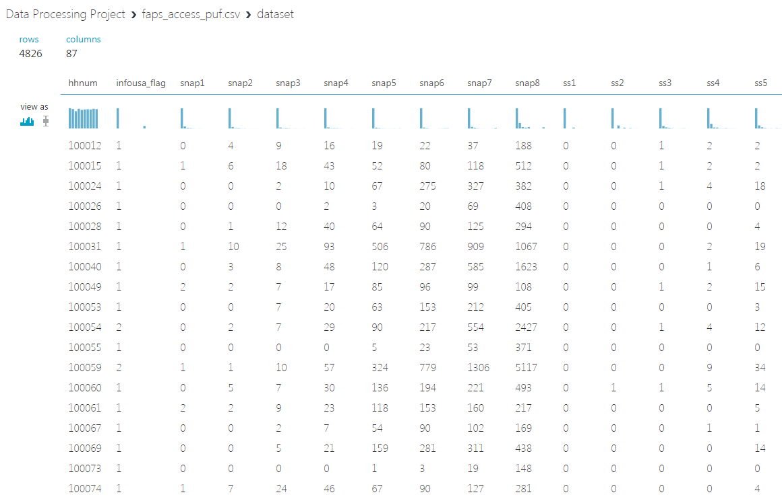
The Data: faps_access_puf.csv
By household
Number of food sources of a type within radius

Slide 8
The Data: faps_access_puf.csv
SNAP - SNAP-authorized retailers
SS - Superstores
SM - Supermarkets
CO - Combination Grocery/Other
CS - Convenience Store
MLG - Medium or Large Grocery
FF - Fastfood Restaurants
NONFF - Non-fastfood Restaurants
1 - 0.25 mi
2 - 0.50 mi
3 - 1.00 mi
4 - 2.00 mi
5 - 5.00 mi
6 - 10.0 mi
7 - 15.0 mi
8 - 30.0 mi

Slide 9
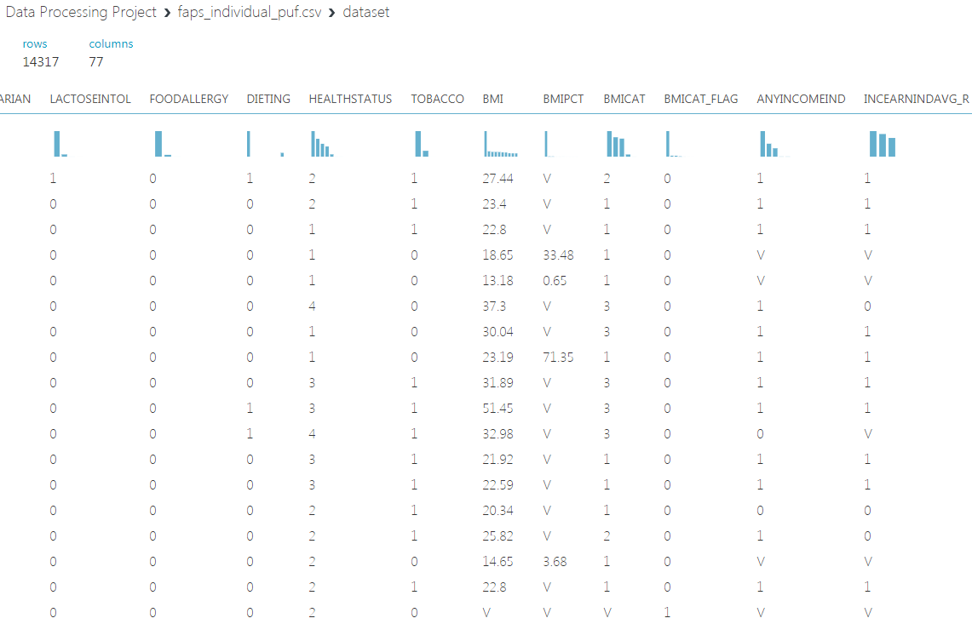
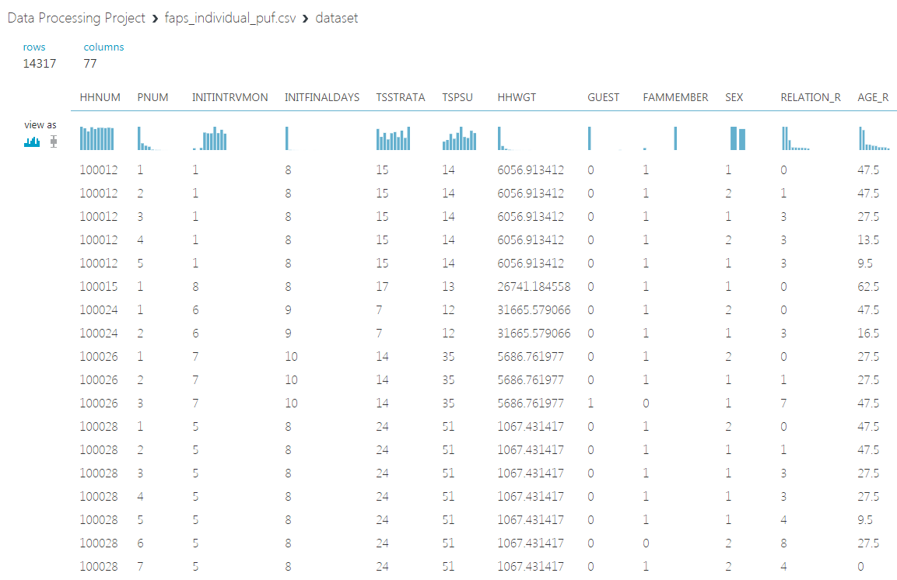
The Data: faps_individual_puf.csv
By household and person number within household
Only need a few columns

Slide 10
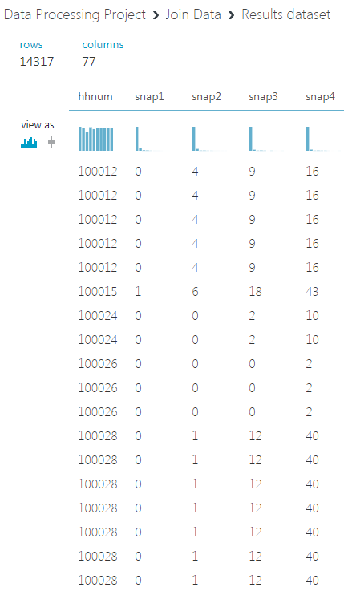
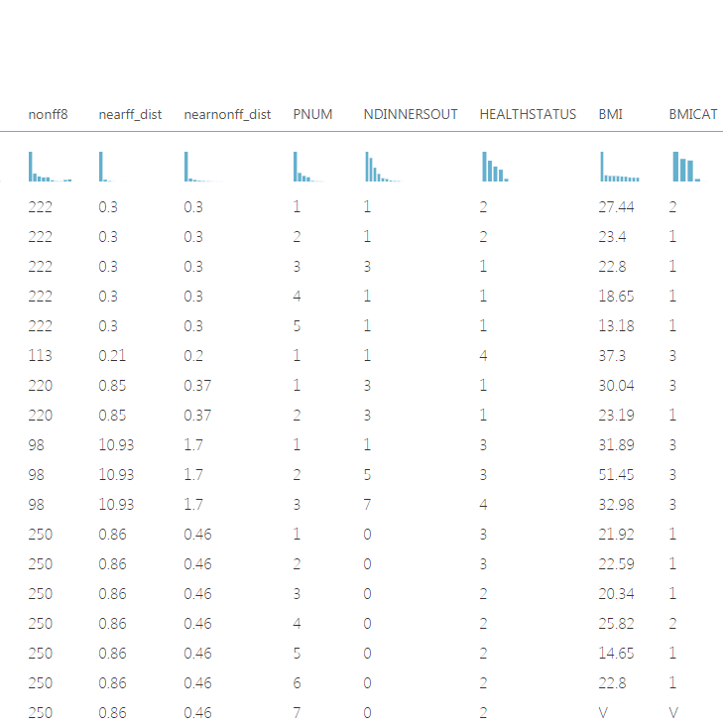
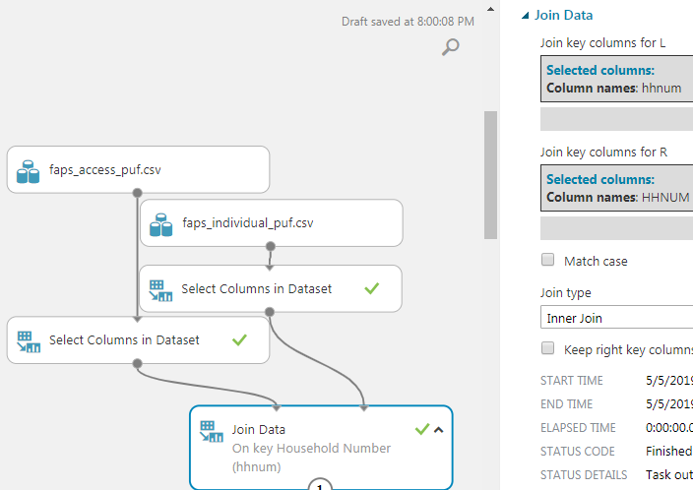
Data Preparation
Join access and individual information by household, "hhnum" column

Slide 11
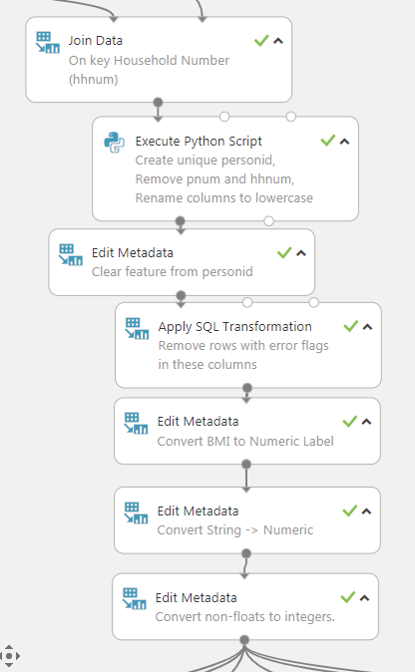
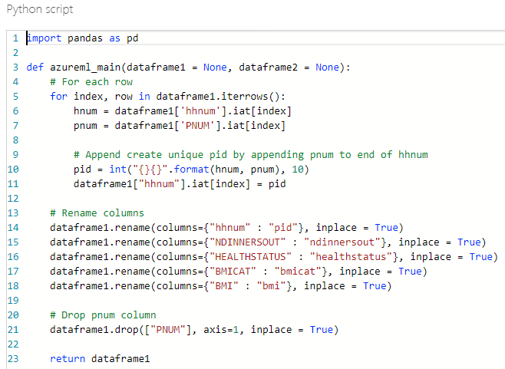
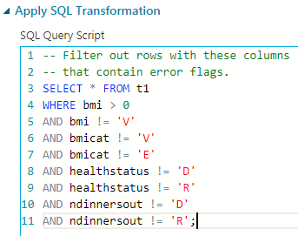
Data Preparation
Create personid ('pid') column from 'hhnum' and 'pnum'
Remove rows with errors
Ensure correct metadata

Slide 12
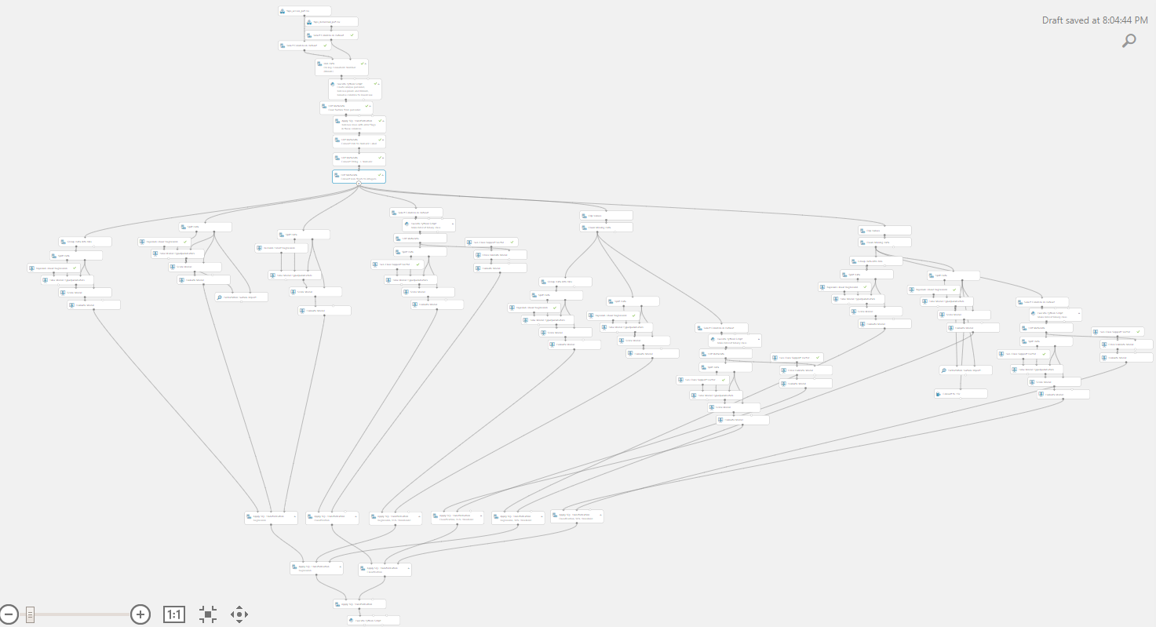
The Model

Slide 13
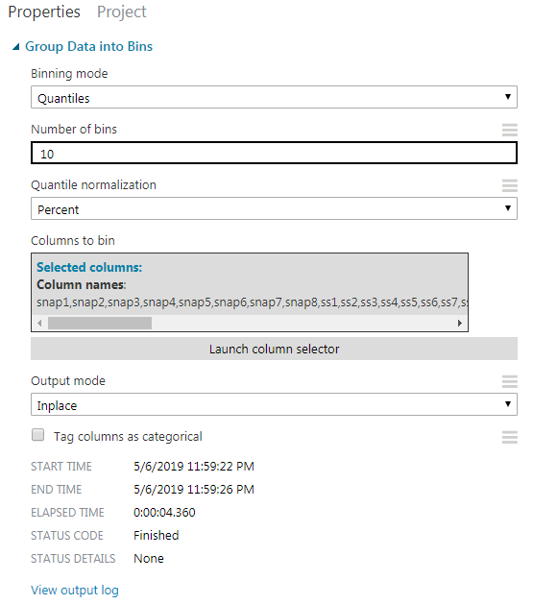
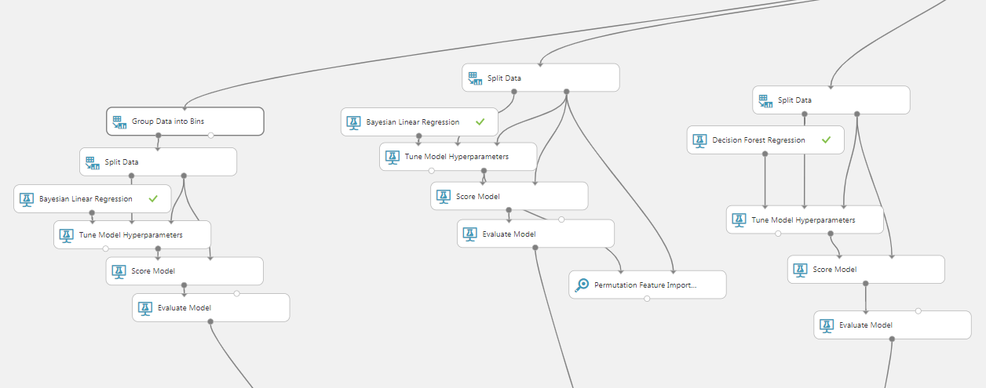
Regression
Binned and not-binned Bayesian, Decision Forest

Slide 14
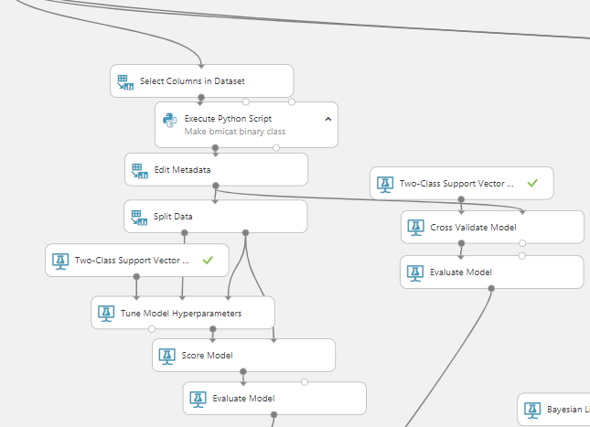
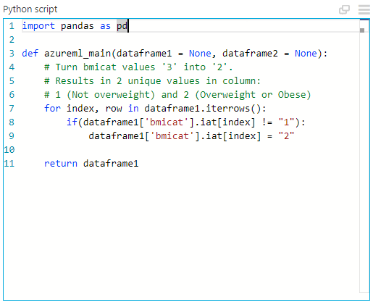
SVM Classification
Predicting "bmicat"

Slide 15
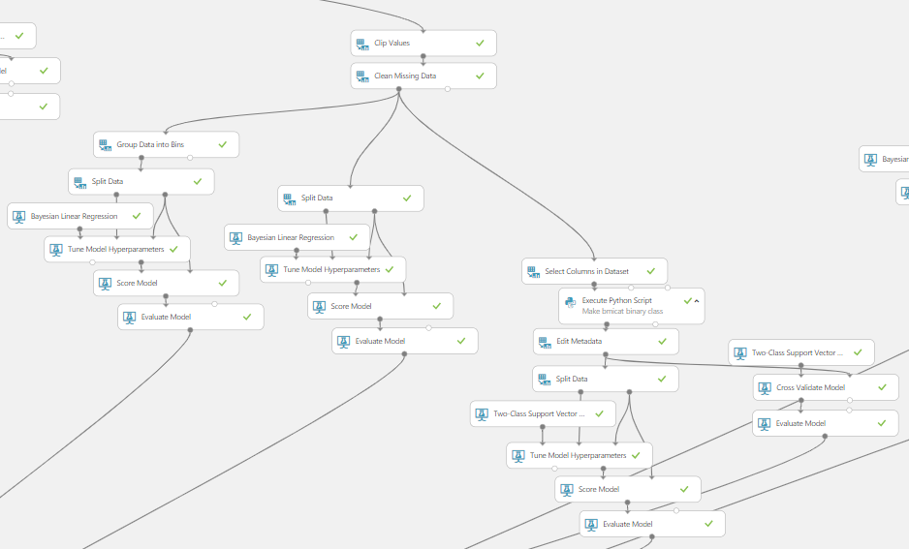
Bayesian Regression and SVM Classification I
Clip values above 95 percentile
Regr. Bin
Regr. No Bin
SVM
SVM, X-Validated

Slide 16
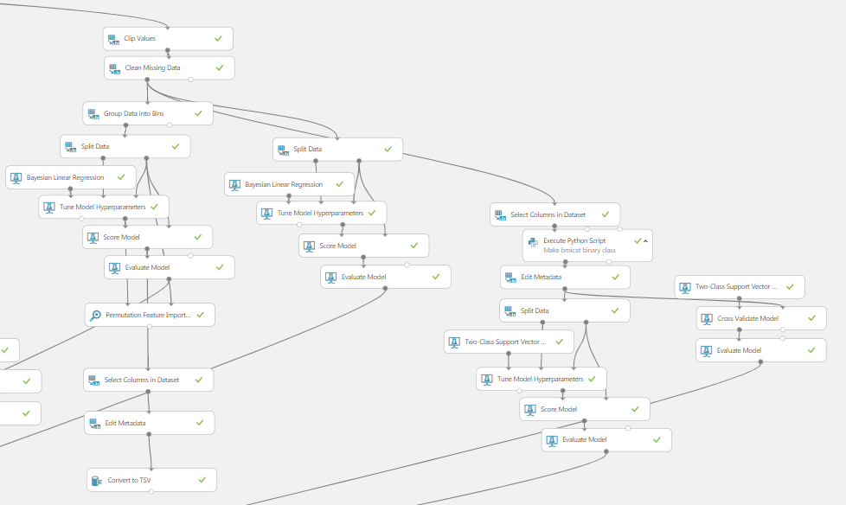
Bayesian Regression and SVM Classification II
Clip values above 90 percentile
Regr. Bin
Regr. No Bin
SVM
SVM, X-Validated

Slide 17
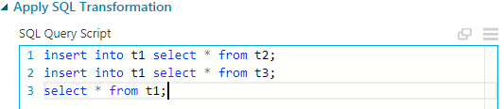
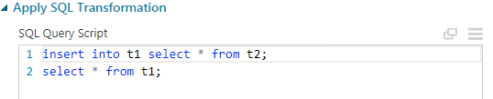
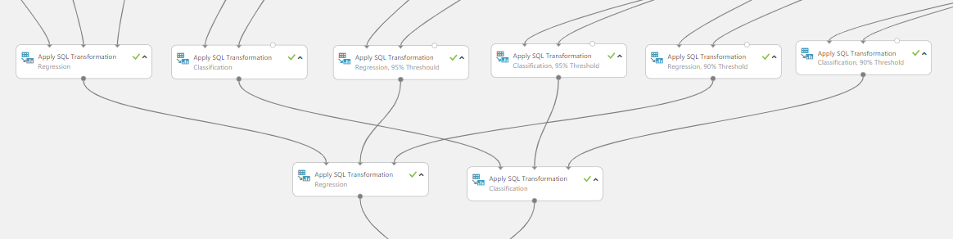
Organize Evaluation Results
Collect regression and classifications into own table

Slide 18
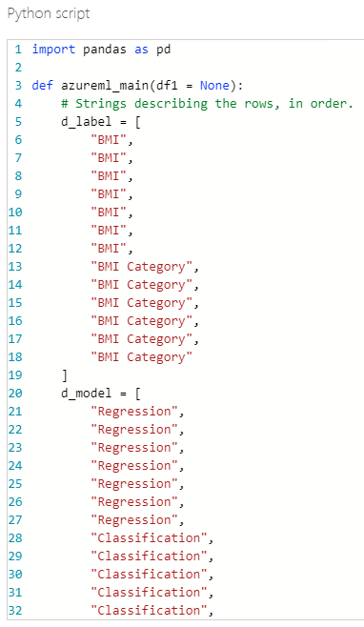
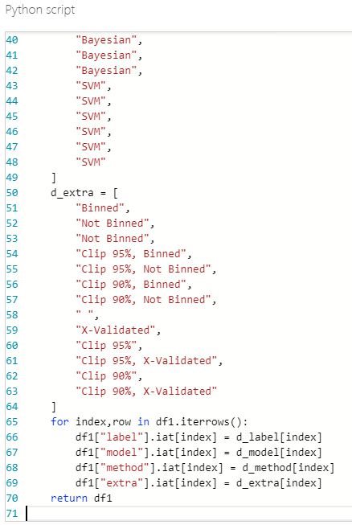
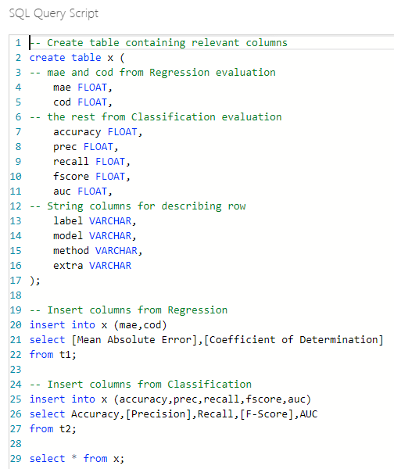
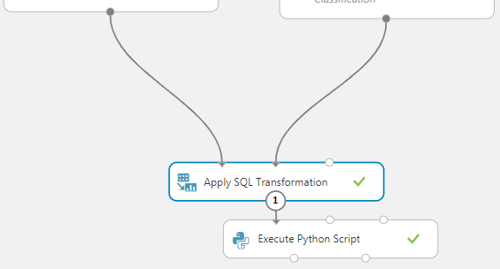
Collect Evaluation Metrics into Single Table
Create table to accommodate relevant columns from both regression and classification evaluations

Slide 19
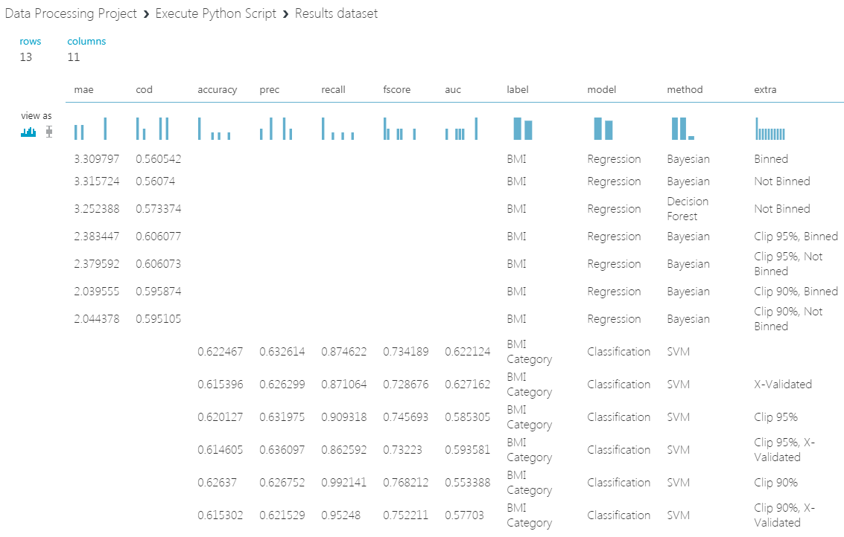
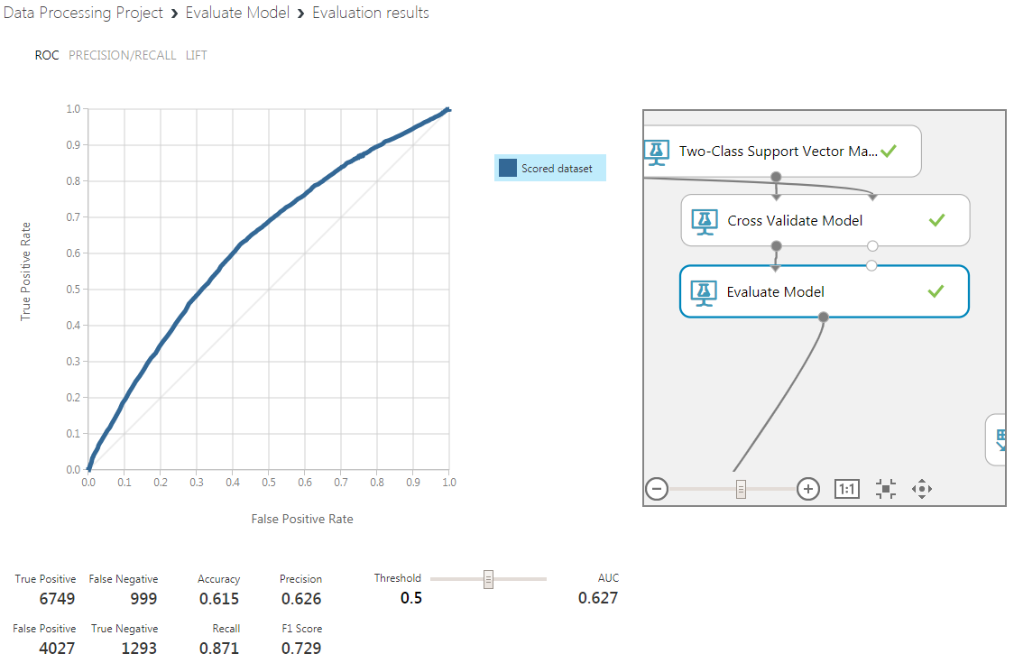
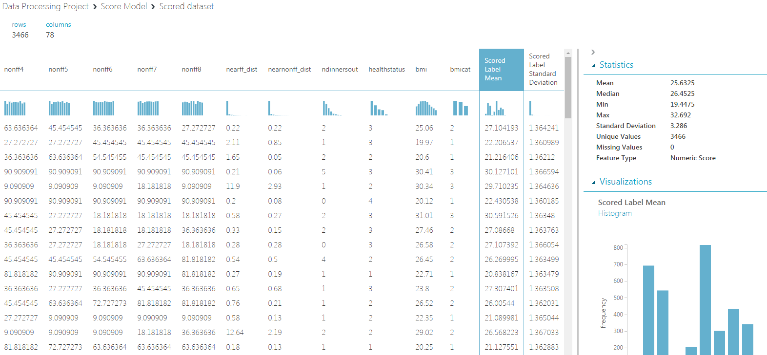
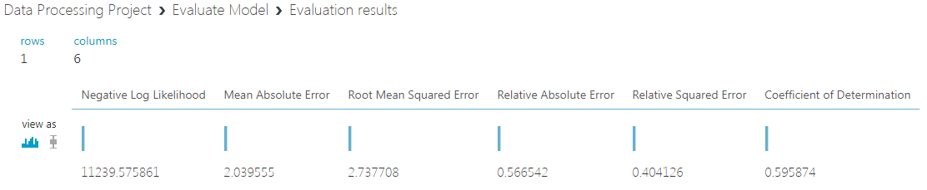
Model Evaluation Results

Slide 20
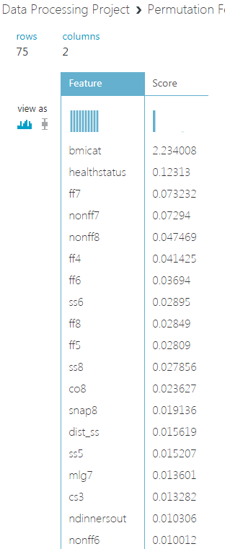
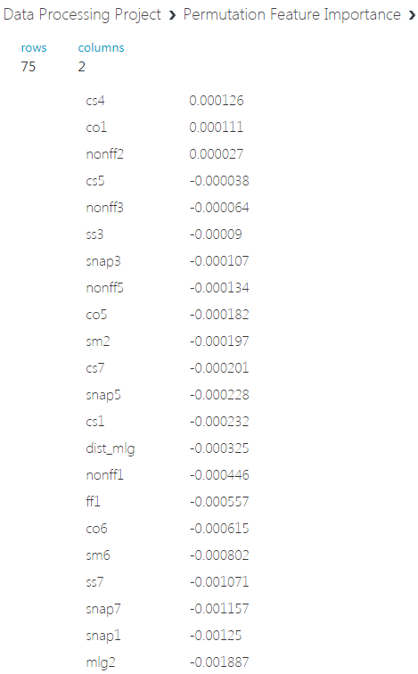
Permutation Feature Selection

Slide 21
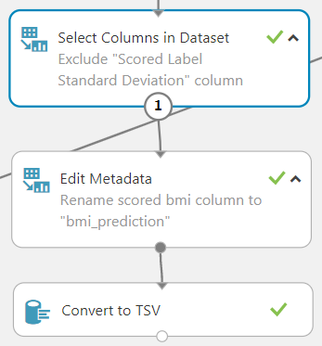
Preparing Data for Export to Elasticsearch
The 90% clipped and binned regression results
Minor edits to dataset before exporting as tsv file

Slide 22
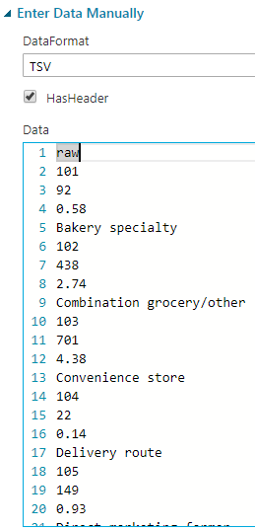
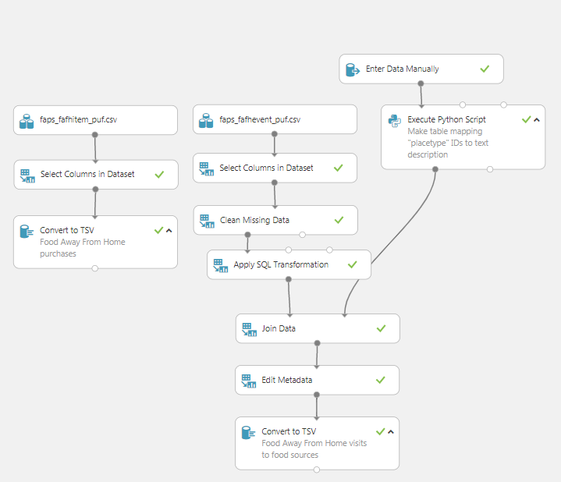
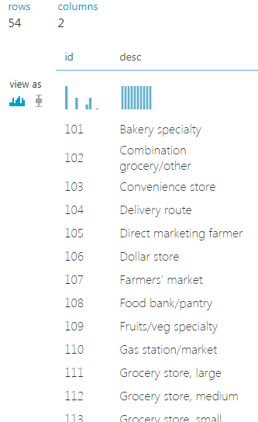
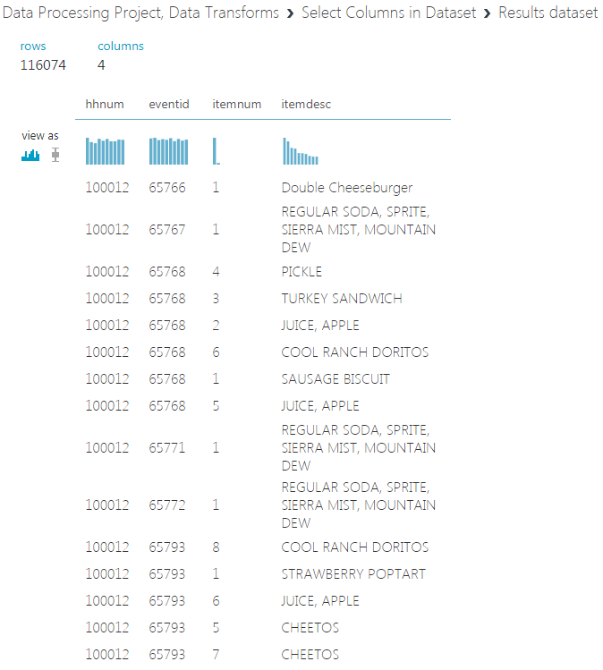
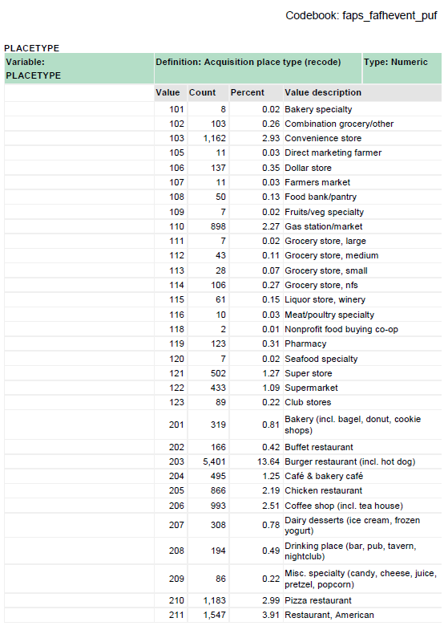
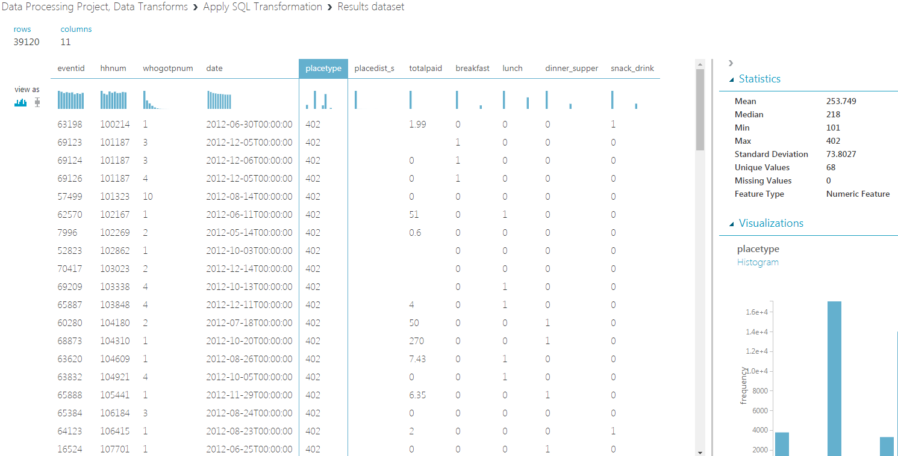
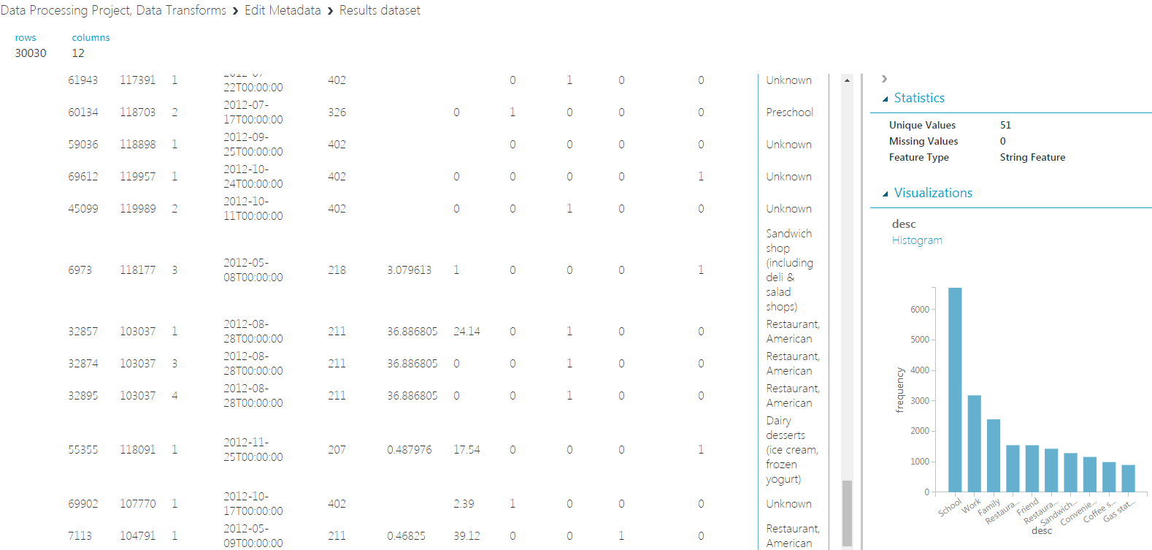

Extra data for visualizing in Elasticsearch
fafh items
fafh events

Slide 23


Elasticsearch
Uploading scored dataset
Used the best one (90% binned regression)

Slide 24


Elasticsearch
Change settings in "Advanced" tab
Type in index name
Alter "pid" mapping:
type to "text"

Slide 25


Elasticsearch
Did the same to import "fafh_item" and "fafh_event"
But for fafh_item's "itemdesc" and fafh_event's "desc" column, add "fielddata" to mapping to allow aggregation

Slide 26


Elasticsearch
And fafh_event's "date" field type needs to be changed to date.
And format specified.

Slide 27



Elasticsearch
Verify index in Discover

Slide 28








Elasticsearch: BMI Prediction Histogram

Slide 29



Elasticsearch: Food Away From Home
How many people went out on a given day

Slide 30







Elasticsearch: Tag Cloud
Text

Slide 31

Elasticsearch: Tag Cloud

Slide 32
Links/References
USDA FoodAPS: https://www.ers.usda.gov/data-products...
Microsoft Azure ML Studio Pricing: https://azure.microsoft...
Elasticsearch Hardware Reference: https://www.elastic.co...
Project Github: https://github.com/shozonu/usda-foodaps...
Azure ML Project Gallery:

